Slide 1
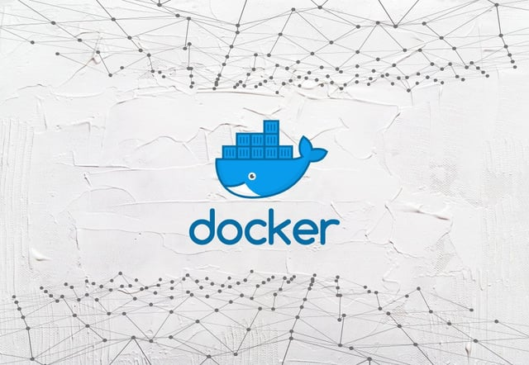
Contapache: Docker Custom Image Creation
CY5001, Assignment 4.2
Project by:
Aishwarya Channappaji
NUID#002298741

Slide 2
Develop a Python script which changes the index.html file content automatically when a docker image is run.
Objective:
Justification:
Approach Used:
Dockerfile to run the python script in order to change the index.html file of a docker container.
To do so, I have included 3 files:
a. Dockerfile: Script containing instructions to build a docker image
b. Python Script: The script includes the changes that has to be made to index.html file when we run a container.
c. Entrypoint script: bash script which allows you to provide a default behavior for your container.

Slide 3
Major challenge that I faced was to link my python script to docker file. Including python script in docker file was giving me multiple errors while creating the image.
Roadblocks:
Solution:
In order to overcome this, I used entrypoint script. ENTRYPOINT instruction specifies that the entrypoint.sh script should be the default command to run when a container based on this image starts.

Slide 4
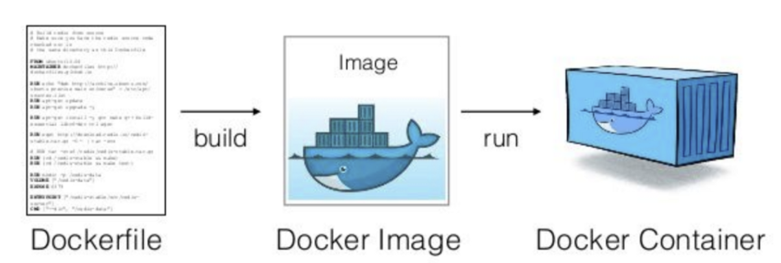
Development explanation
High Level Working:
Dockerfile
Entrypoint Script
Python Script

Slide 5
Development explanation
Low Level Working:
Approach used in Python script:
I have defined a function modify_index_html(). Edits the content and writes to the image
The main function calls modify_index_html(), passes the ‘name’ parameter and executes.

Slide 6
Potential Future Improvements
Enhance Python Script: Improvising the Python script for various other uses along with index.html file customization. This could include adding authentication and authorization features where the script can handle secure access to the image
Enabling Security Headers: We can enable HTTPS in the python script to ensure secure communication between client and server.
Regular Update and Upgrade: Keeping the image up to date with patches is very crucial in order to avoid exposing the containers to vulnerabilities and prone to attack. I have already added this feature in my dockerfile. Every time the image is run, it first updates and upgrades before any other operation is run.

Slide 7
Thank You

